Slide 1
EECS151/251A Discussion 2
Christopher Yarp
Feb. 1, 2019

Slide 2
Verilog

Slide 3
Hardware Description Language
The lecture, the FPGA lab, and the ASIC lab all involve describing hardware designs!
How do we describe a hardware design?
Hardware Description Languages (HDL)
Many HDLs Exist:
Verilog
VHDL
SystemVerilog
SystemC
Chisel
…

Slide 4
HDLs are not Like C
People commonly say that Verilog has a C like syntax
Operators (+, -, &&, ||, …) are generally the same
Both use semicolons at the ends of statements
Single line comments start with //, block comments are enclosed in /* … */
That is pretty much where the similarities end
HDLs are languages for describing a hardware design
Combinational logic will be running in parallel … at all times!
If any input to combinational logic changes, it will immediately begin producing the new result (output will come after some delay)
Multiple state elements can change state simultaneously at a clock edge

Slide 5
Using HDLs
Many HDLs originated as simulation languages
Not all Verilog is “synthesizable” (can be interpreted by the FPGA or ASIC tools to represent a design)
You will be working with a subset of the Verilog language
Look over the “Verilog Primer” Slides on the Website
Under “Resources”
Notes:
This is already being covered in lecture and in labs. My hope is to go over some parts of Verilog that are typically confusing or unintuitive.

Slide 6
Module Instances are not function calls
You are basically connecting wires to input and output ports of the module instance
Both input and output wires are connected inside the parentheses
wire [4:0] in1, in2;
wire [6:0] out1;
//This is creating an instance of the module five_bit_adder called adder1
//It is wiring input port a of five_bit_adder to in1, input port b to in2
//It is wiring the output port out to out1
five_bit_adder adder1 (.a(in1), .b(in2), .out(out1));

Slide 7
The always @ block
always @ blocks have the following syntax:
always @(sensitivity list) begin … end
At a high level, you are telling Verilog the statements contained in the always @ block should only change when a signal in the sensitivity list has changed

Slide 8
The always @ block – Combinational Logic
For combinational logic, you should list any referenced signal
a signals that appears on the right hand side of assignment statements
a signal used in a conditional statement
Supplying an incomplete sensitivity list can result in unexpected behavior
Verilog allows you to specify always @(*)
With this, Verilog will determine the proper combinational logic sensitivity list for you!
Use this whenever you want to use an always block to describe combinational logic.
reg out;
wire, a, b, c;
always @(a, b, c) begin
if(a) begin
out = b;
end else begin
out = c;
end
end

Slide 9
The always @ block – Sequential Logic
The sensitivity list allows us to describe sequential logic (registers)
Use posedge or negedge to describe an edge triggered flip-flop (register)
wire clk, D;
reg Q;
always @(posedge clk) begin
Q <= D;
end
In this case, when there is a 0->1 transition of clk, the body of the always block occurs.
In this case, it assigns Q to the value of D
D
Q
clk

Slide 10
Reg vs. Wires
wire
reg
Used when connecting modules in structural Verilog
wire a, b, clk;
Used for continuous assignments
wire a, b, c;
assign a = b | c;
Despite what it’s name implies, reg types are not always registers
Any assignment made inside an always block must be to a reg
Including always @(*) blocks
If the sensitivity list contains an edge event (ex. posedge clk), reg types will likely be inferred as registers*
*depending on the type of assignment statement used

Slide 11
Multiple Assignments
You cannot assign a wire more than once
assign a = b;
assign a = c; //Bad!
This creates a “multi-driver” net which is not allowed by most synthesis tools.
What happens when b is 0 and c is 1? Is ‘a’ 0 or 1?
What happens if b is 1 and c is 1? Is ‘a’ 0, 1, or 2?
However, you can assign a reg in multiple places within an always @ block
always @(posedge clk) begin
a <= b;
if(d>16’d5) begin
a <= c;
end
end
The last assignment statement ”executed” will be the one that ultimately assigned.
a <= c if d>16’d5
Otherwise a <= b
Can be used to set a “default value" for a reg
Notes:
The assign statement is known as a continuous assignment. It is defined (based on section 9.2 of the standard) that the driver updates whenever an input operand changes value.
By contrast the <= and = assignments are known as procedural assignments and are assigned according to the “procedureal flow constraints”
I would guess that the last “executed” assignment wins is probably a function of the event driven simulation heritage of Verilog. It can keep enquing events and the last one wins.
One reason to assign

Slide 12
Blocking Vs. Nonblocking Assignments
Blocking Assignment (=)
Nonblocking Assignment (<=)
The assignment takes place immediately (with respect to other assignments).
Any reference to the assigned reg in a later statement will see its new value
Use this for combinational logic
reg c, out;
wire a, b, d;
always @(*) begin
c = a | b;
out = c & d;
end
Equivalent to: out = (a | b) & d
The assignment is deferred until the end of the time step (until all the right hand sides have been evaluated)
Logic can reference the values of registers before they are updated in this cycle (ie. values immediatly before the clock edge)
Allows multiple registers to be written to simultaneously (order does not matter)
Use this for sequential logic
reg c, out;
wire a, b, clk;
always @(posedge clk) begin
//use val of ‘out’ before clk edge
c <= out | a;
//use val of ‘c’ before clk edge
out <= c & b;
end

Slide 13
Generate for loops are not like C loops
You are not describing iterations of execution
Cannot store a value in a temporary variable to be read and overwritten in the next iteration
Think of it like writing a little program that writes Verilog
genvar i;
wire [2:0] a;
wire [3:0] b;
generate
for(i = 0; i<3; i = i+1) begin:loop
mod inst(.a(a[i]), .b(b[i]), .c(b[i+1]));
end
endgenerate
The generate loop is structurally equivalent to
wire [2:0] a;
wire [3:0] b;
mod inst_loop_0(.a(a[0]), .b(b[0]), .c(b[1]));
mod inst_loop_1(.a(a[1]), .b(b[1]), .c(b[2]));
mod inst_loop_2(.a(a[2]), .b(b[2]), .c(b[3]));
If you want a C like loop using a single instance of a module, you need to construct the control logic to manage the multi-cycle execution yourself – generate for will not do it for you

Slide 14
Simulating Verilog

Slide 15
Simulating Verilog
ASIC Lab has started talking about this already
FPGA Lab will cover it in Lab 3
I’ll show you a simple example today
Need a testbench to specify your test case
Typically is a module that instantiates the module your are interested as the DUT (device under test)
Typically uses an “initial” block to manipulate signals
Initial blocks are run at the start of the simulation

Slide 16
An Example Testbench
`timescale 1ns/1ns
module reg_tester();
reg clk;
reg [4:0] a;
wire [4:0] b;
//Set the initial state of the clock
initial clk = 0;
//Every 4 timesteps (1ns/step) flip the clock
always #(4) clk <= ~clk;
//Instantiate the DUT
five_bit_flip_flop dut(.clk(clk), .d(a), .q(b));
initial begin
$dumpfile("dump.vcd"); //Setup file dump (for waveform viewer)
$dumpvars; //Dump signals to dumpfile
a = 5'd0; //Set inputs
//Print these values at the end of the current simulation step
$strobe("time: %4d, a: %d, b: %d, clk: %b", $time, a, b, clk);
#4; //Go for 4 ns
$strobe("time: %4d, a: %d, b: %d, clk: %b", $time, a, b, clk);
#1; //Go for 1 ns
$strobe("time: %4d, a: %d, b: %d, clk: %b", $time, a, b, clk);
#1; //Go for 1 ns
a = 5’d2; //Set inputs
$strobe("time: %4d, a: %d, b: %d, clk: %b", $time, a, b, clk);
#6; //Go for 6 ns
$strobe("time: %4d, a: %d, b: %d, clk: %b", $time, a, b, clk);
#1; //Go for 1 ns
$strobe("time: %4d, a: %d, b: %d, clk: %b", $time, a, b, clk);
#8; //Run for another clock cycle + 1ns
$strobe("time: %4d, a: %d, b: %d, clk: %b", $time, a, b, clk);
$finish(); //End the simulation
end
endmodule

Slide 17
Result!
”X” means unknown
time: 0, a: 0, b: x, clk: 0 time: 4, a: 0, b: 0, clk: 1 time: 5, a: 0, b: 0, clk: 1 time: 6, a: 2, b: 0, clk: 1 time: 12, a: 2, b: 2, clk: 1 time: 13, a: 2, b: 2, clk: 1

Slide 18
Some useful “System Tasks”
$strobe(“format str”, values …)
Prints values to the console. Is executed at the very end of the current cycle (after all changes have propagated)
In Verilog parlance, this executes after “all simulation events have occurred for the simulation time”
$time
Get the current simulation time
$monitor(“format str”, values …)
Prints values to the console when any of them change
Only 1 monitor statement can be active at a time
$finish()
End the simulation
$display(“format str”, values …)
Similar to $strobe except it is not guaranteed to be executed at the end of the current cycle

Slide 19
Printing every cycle
`timescale 1ns/1ns
module reg_tester();
reg clk;
reg [4:0] a;
wire [4:0] b;
//Set the initial state of the clock
initial clk = 0;
//Every 4 timesteps (1ns/step) flip the clock
always #(4) clk <= ~clk;
//Instantiate the DUT
five_bit_flip_flop dut(.clk(clk), .d(a), .q(b));
initial begin
$dumpfile("dump.vcd"); //Setup file dump (for waveform viewer)
$dumpvars; //Dump signals to dumpfile
a = 5'd0; //Set inputs
#6; //Go for 6 ns
a = 5’d2; //Set inputs
#15; //Go for 6 ns
$finish(); //End the simulation
end
initial begin
forever begin
$strobe("time: %4d, a: %d, b: %d, clk: %b", $time, a, b, clk);
#1;
end
end
endmodule

Slide 20
Result!
time: 0, a: 0, b: x, clk: 0 time: 1, a: 0, b: x, clk: 0 time: 2, a: 0, b: x, clk: 0 time: 3, a: 0, b: x, clk: 0 time: 4, a: 0, b: 0, clk: 1 time: 5, a: 0, b: 0, clk: 1 time: 6, a: 2, b: 0, clk: 1 time: 7, a: 2, b: 0, clk: 1 time: 8, a: 2, b: 0, clk: 0 time: 9, a: 2, b: 0, clk: 0 time: 10, a: 2, b: 0, clk: 0 time: 11, a: 2, b: 0, clk: 0 time: 12, a: 2, b: 2, clk: 1 time: 13, a: 2, b: 2, clk: 1 time: 14, a: 2, b: 2, clk: 1 time: 15, a: 2, b: 2, clk: 1 time: 16, a: 2, b: 2, clk: 0 time: 17, a: 2, b: 2, clk: 0 time: 18, a: 2, b: 2, clk: 0 time: 19, a: 2, b: 2, clk: 0 time: 20, a: 2, b: 2, clk: 1

Slide 21
Monitoring
`timescale 1ns/1ns
module reg_tester();
reg clk;
reg [4:0] a;
wire [4:0] b;
//Set the initial state of the clock
initial clk = 0;
//Every 4 timesteps (1ns) flip the clock
always #(4) clk <= ~clk;
//Instantiate the DUT
five_bit_flip_flop dut(.clk(clk), .d(a), .q(b));
initial begin
$dumpfile("dump.vcd"); //Setup file dump (for waveform viewer)
$dumpvars; //Dump signals to dumpfile
a = 5'd0; //Set inputs
#6; //Go for 6 ns
a = 5'd2;
#15; //Go for 6 ns
$finish(); //End the simulation
end
initial begin
$monitor("time: %4d, a: %d, b: %d, clk: %b", $time, a, b, clk);
end
endmodule

Slide 22
Results
time: 0, a: 0, b: x, clk: 0 time: 4, a: 0, b: 0, clk: 1 time: 6, a: 2, b: 0, clk: 1 time: 8, a: 2, b: 0, clk: 0 time: 12, a: 2, b: 2, clk: 1 time: 16, a: 2, b: 2, clk: 0 time: 20, a: 2, b: 2, clk: 1

Slide 23
Simulating in this class
VCS
Introduced in ASIC Lab 2
Installed on Cory 125 Computers
ModelSim
Introduced in FPGA Lab3
Installed on Cory 125 Computers
Educational version (PE) available for Windows
Vivado Simulator
Introduced in FPGA Lab 3
Installed on Cory 125 Computers
Free version (WebPack) can be installed on Linux and Windows (Mac needs a VM)
Install Vivado 2017.4 if you are in the FPGA Lab
EDA Playground (https://www.edaplayground.com)
Free Web Based Simulator
Requires Registration

Slide 24
Blocking vs. Non-Blocking Assignment Conventions
… and why you should follow them

Slide 25
Sequential Logic
Non-Blocking
Blocking
always @(posedge clk)
begin
c <= a & b;
e <= c | d;
end
always @(posedge clk)
begin
c = a & b;
e = c | d;
end
Are these the same module?
Notes:
Move to discussion 2

Slide 26
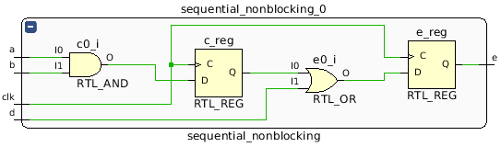
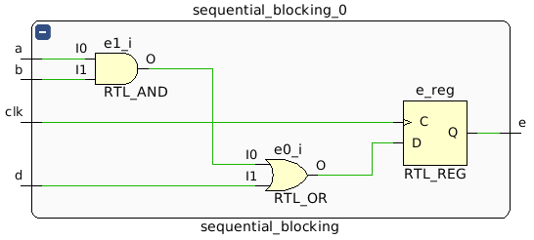
Sequential Logic
Non-Blocking
Blocking
Cycle | A | B | D | Non-Blocking | Blocking
0 | 0 | 1 | 0 | x | x
1 | 1 | 1 | 0 | x | 0
2 | 1 | 1 | 0 | 0 | 1
3 | 1 | 1 | 0 | 1 | 1
4 | 1 | 1 | 0 | 1 | 1
Are these the same module? – No

Slide 27
Combinational Logic
Blocking
Non-Blocking (Input Sensitivity)
Non-Blocking (Intermediate Sensitivity)
always @(a, b, d)
begin
c = a & b;
e = c | d;
end
always @(a, b, d)
begin
c <= a & b;
e <= c | d;
end
always @(a, b, d, c)
begin
c <= a & b;
e <= c | d;
end
Are these the same module?

Slide 28
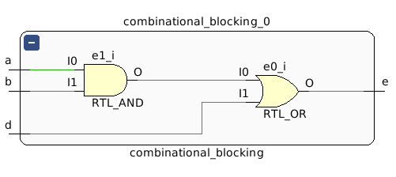
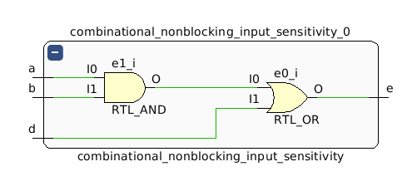
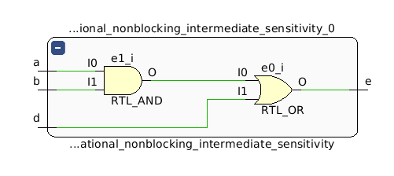
Combinational Logic
WARNING: [Synth 8-567] referenced signal 'c' should be on the sensitivity list [/home/cyarp/test_blocking/combinational_nonblocking_input_only.v:33]
Blocking
Non-Blocking (Input Sensitivity)
Non-Blocking (Intermediate Sensitivity)
Cycle | A | B | D | Blocking | Non-Blocking (Input Sensitivity) | Non-Blocking (Intermediate Sensitivity)
0 | 0 | 1 | 0 | 0 | x | 0
1 | 1 | 1 | 0 | 1 | 0 | 1
2 | 1 | 1 | 0 | 1 | 0 | 1
3 | 1 | 1 | 0 | 1 | 0 | 1
Looks like a latch. Where is it??
Are these the same module? – ??

Slide 29
Keep to the Rules of Thumb
Sequential Logic: Use non-blocking assignments
Combinational Logic: Use blocking assignments
You can always break up your sequential logic into combinational and sequential components
always @(*)
begin
c = a & b;
next_state = c | state;
end
always @(posedge clk)
begin
state <= next_state;
end
Comb. Logic
Comb. Logic
D
Q
clk

